Slide 1
IS4432 Systems Design
Week 1 Introduction & Revision
Adapted by Janet Yu
115/11/08
IS4432

Slide 2
Agenda
Introduction
Course Overview and Assessment
Review on Systems Analysis
  Systems Development Methodologies
  Use Case Diagram
  Use Case Descriptions
  Activity Diagrams
  Class Diagrams
Group Game – Review UBL case
115/11/08
IS4432

Slide 3
Introduction
Janet Yu
Tel: 3442-7542
Office: P7713
Email/Facebook: janetyu@cityu.edu.hk
115/11/08
IS4432

Slide 4
Course Assessment
Continuous Assessment 15%
  Class Participation 5%
  3 in-class assignments 10%
Project (due in week 12) 35%
  Report 25%
  Group Presentation 5%
  Individual Presentation 5%
Final Exam 50%
115/11/08
IS4432

Slide 5
Review on
Systems Analysis
115/11/08
IS4432

Slide 6

Why Information Systems Fail?
Analysts tried to build systems without understanding the requirements.
System creates little value for the organization.
115/11/08
IS4432

Slide 7
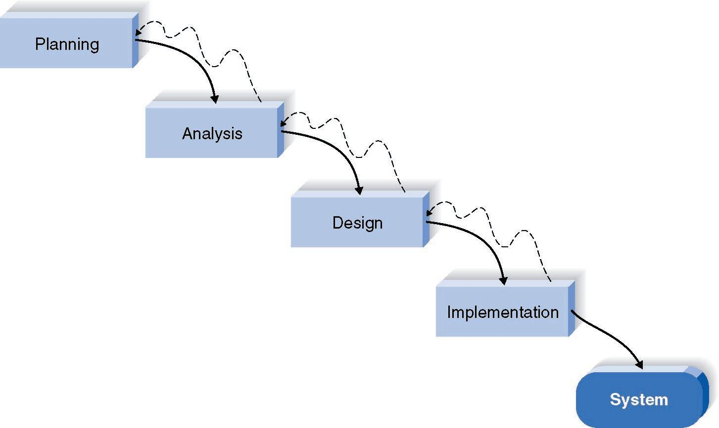
System Development Methodologies
Waterfall Development Method?
Parallel Development?
Prototyping?
115/11/08
IS4432

Slide 8
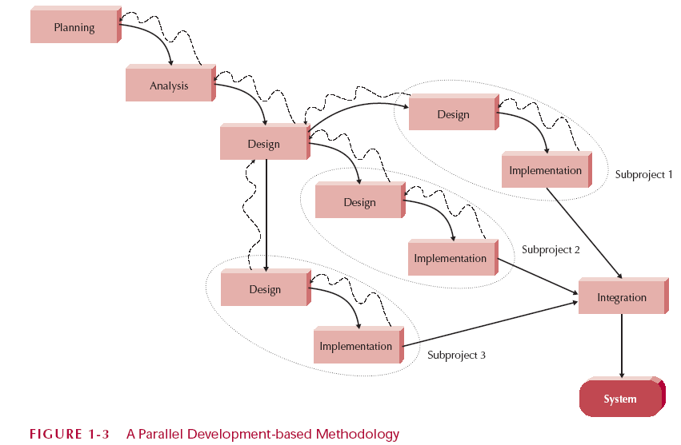
System Development Methodologies
Waterfall Development Method?
Parallel Development?
Prototyping?
115/11/08
IS4432

Slide 9
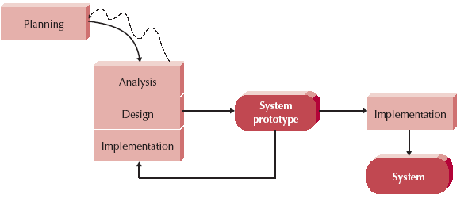
System Development Methodologies
Waterfall Development Method?
Parallel Development?
Prototyping?
115/11/08
IS4432

Slide 10

Systems Development Life Cycle (SDLC)
Planning
  Why build the system?
Analysis
  What are the business needs?
Design
  How to build the system?
Implementation
  System delivery
115/11/08
IS4432

Slide 11
Systems Analysis Course
Feasibility Study
Functional vs non-functional requirements
Functional Modeling
  Use Case Diagram - a graphical overview of the main functionality of a system
  Use Case Description - captures detailed interaction between user and the system
  Activity Diagram - describes workflow of activities
Structural Modeling
  Class Diagram - describe the structure of the data that supports the business processes
115/11/08
IS4432

Slide 12
Feasibility Studies
Technical
Economic
Organization
Schedule
115/11/08
IS4432

Slide 13
Non-Functional Requirements
Operational
Performance
Security
Cultural and Political
115/11/08
IS4432

Slide 14
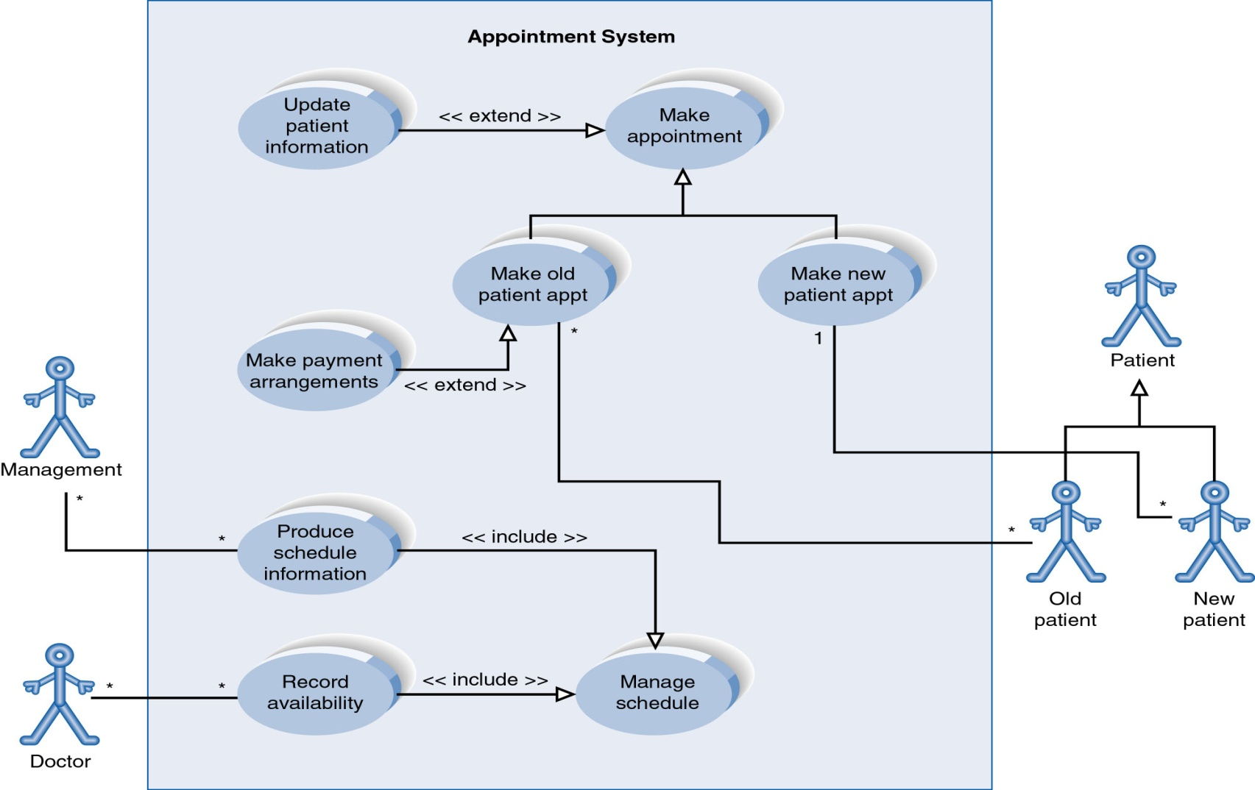
Use Case Diagram
115/11/08
IS4432

Slide 15

Use Case Description
Use case name | Take delivery order
Primary actor | Staff (at the Hotline)
Pre-conditions | Staff is identified and authenticated
Post-conditions | Customer details are added if he/she is new; Order is recorded with total price, estimated delivery time for the Customer;
Trigger | Staff receives a call from a Customer (existing or new) for a pizza delivery
115/11/08
IS4432

Slide 16
Use Case Description
Main Success Scenario | Staff enters the phone number of the Customer System finds customer details based on the phone number and displays the name and address Staff confirms name and address with the Customer Staff asks the Customer for menu item or combo item Staff enters the item code into the system System verifies item availability and adds it to the order Staff repeats steps 4-6 for each item of ordered by Customer System calculates and presents total price System estimates and displays the expected delivery time (based on preparation time and travel time to Customer’s address) Staff confirms the order after informing the Customer the total price and the expected delivery time System records the completed order
115/11/08
IS4432

Slide 17
Use Case Description
Extensions | 2a. 1. System finds that the Customer is new 2. Staff enters customer name, phone number and address and returns to Step 4. 6a. 1. System finds that the item is not available for order 2. Staff informs the Customer and returns to Step 4. 9a. Customer cancels the order and hangs up. …
115/11/08
IS4432

Slide 18
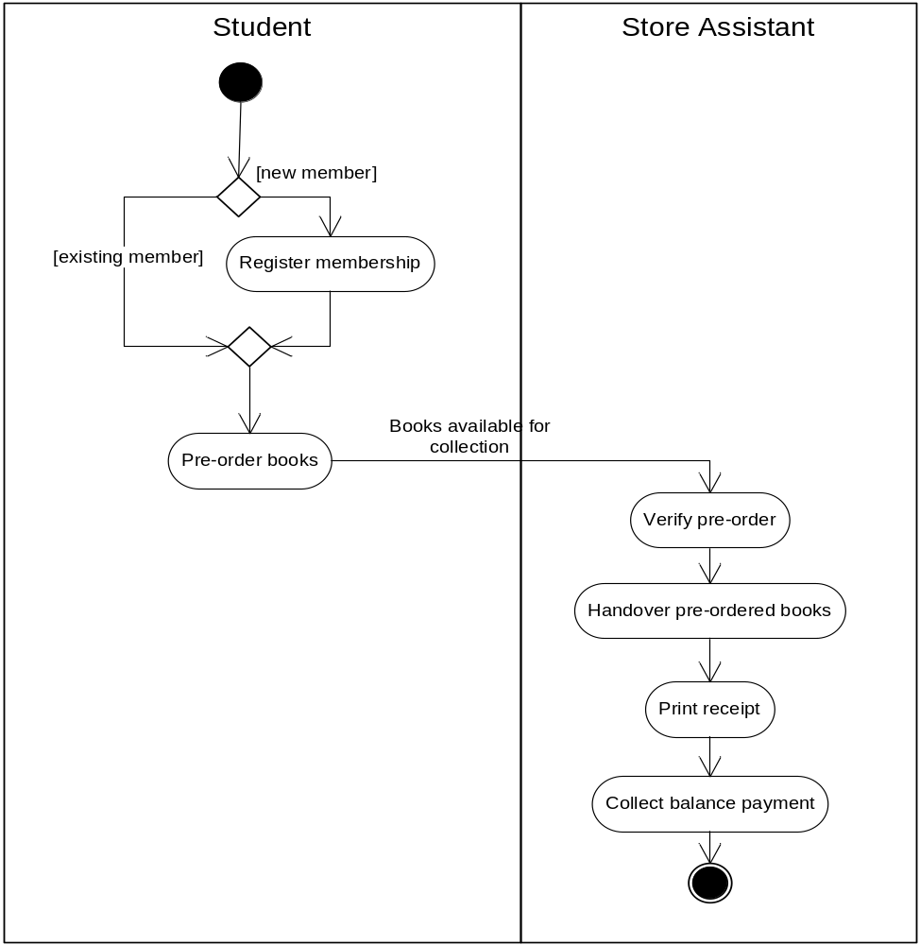
Activity Diagram
115/11/08
IS4432

Slide 19
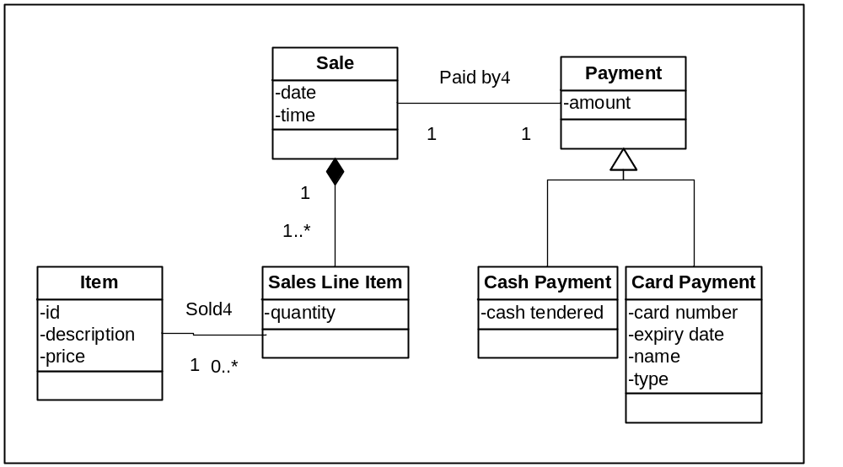
Structural Model - Class Diagram
http://www.agiledata.org/essays/objectOrientation101.html
115/11/08
IS4432

Slide 20
Group Game
Members of top two winning groups get class participation marks
Read the UBL case materials (30mins)
115/11/08
IS4432

